Slide 1

Sistemas Operacionais
RAM Disk × SSD × HDD RAID 5
RAM: Random Access Memory
SSD: Solid State Drive
HDD: Hard Disk Drive
RAID:Redundant Array of Independent Disks
Prof. Sérgio Ricardo Rota pf0112@fiap.com.br www.fiap.com.br

Slide 2
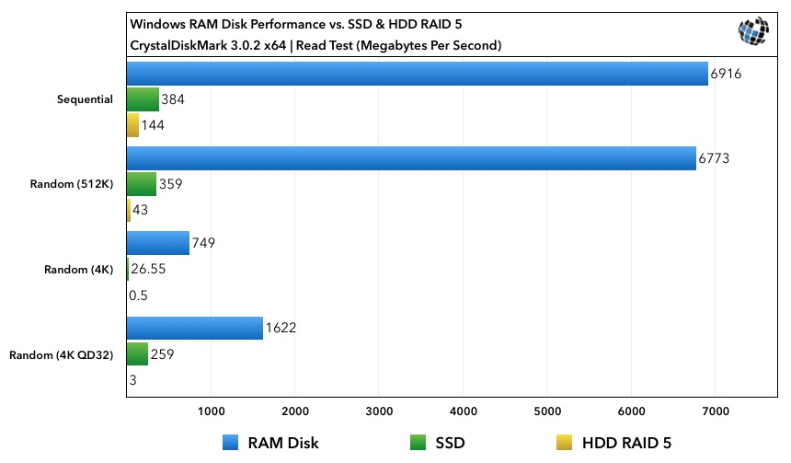
RAM Disk × SSD × HDD RAID 5

Slide 3
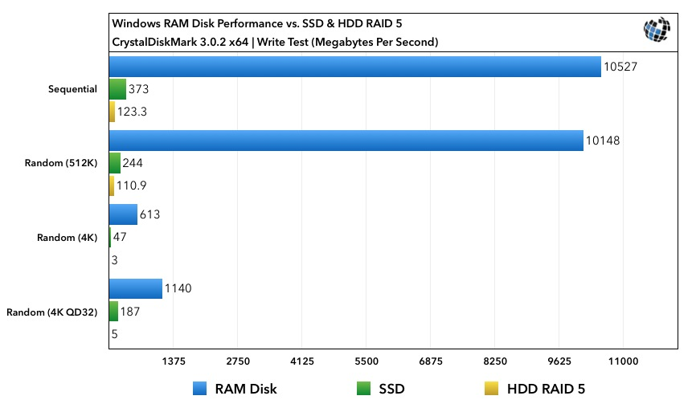
RAM Disk × SSD × HDD RAID 5

Slide 4
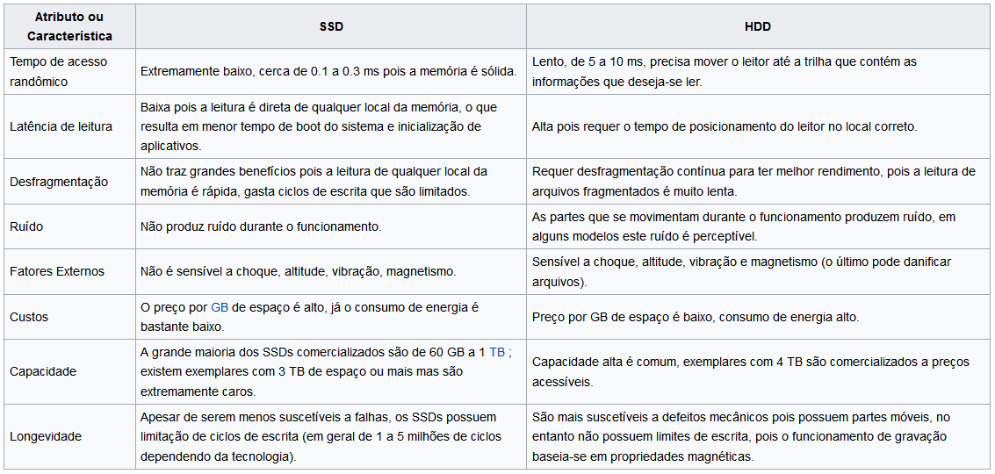
SSD × HDD

